Slide 1
Health Promotion
Dr. Manuja Perera
Department of Public Health
02.07.2018

Slide 2
Health
Public Health
New Public Health

Slide 3
Health
Constitution of WHO, 1948
Health is a complete state of physical, mental and social well-being and not merely the absence of disease or infirmity
Positive – talk about well-being, not absence of disease
Consider several dimensions – physical, mental and social

Slide 4
What is Well-being???
What is physical well-being?
What is mental well-being?
What is social well-being?

Slide 5
Elements of Physical well-being
Growth and development
Strength
Energy
Resistance to infections

Slide 6
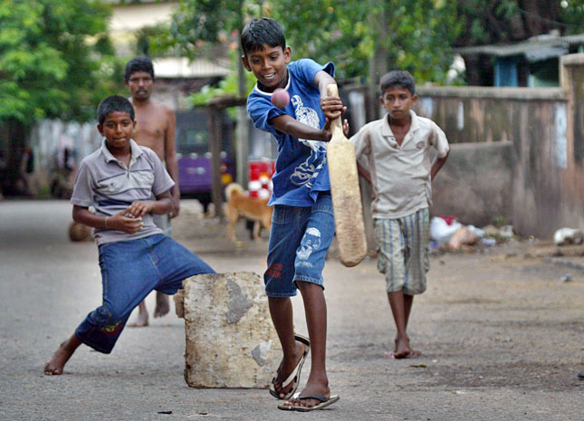

Slide 7
Elements of Mental well-being
Enthusiasm
Variety of interest
Ability to handle stress
Self esteem
Creativity
Ability to make decisions
Aesthetic appreciation

Slide 8
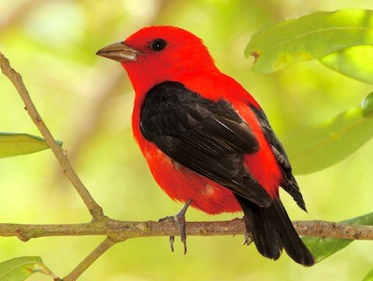

Slide 9
Elements of Social well-being
Relating well to others
Loving and being loved
Respect for differences
Autonomy
Social adjustment
Stigma

Slide 10
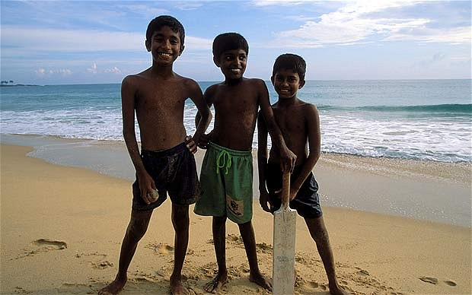

Slide 11
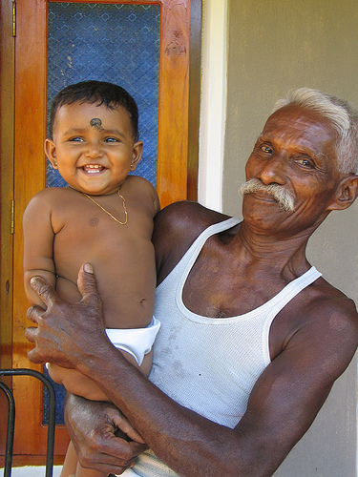

Slide 12
Public Health
"the science and art of
preventing disease, prolonging life and promoting health,
through organized efforts and informed choices of
society, organizations, communities and individuals."

Slide 13
Health Promotion & New Public Health

Slide 14
1984 Copenhagen
“a process of enabling people to control over, and to improve their health”
Process
Enable people - a greater control
Improve health

Slide 15
1986
Official birth of the health promotion approach
At Ottawa, Canada
Ottawa Charter for Health Promotion

Slide 16

“Health is
created and lived by
people
in the settings
of everyday life – where they
learn, work, play and love”

Slide 17
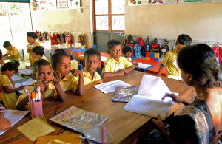
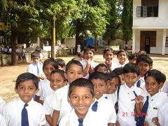
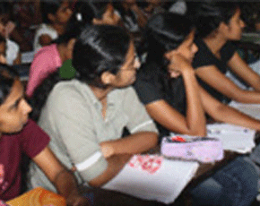
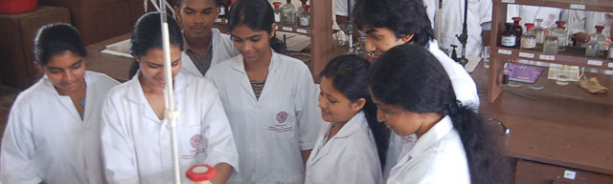

Slide 18
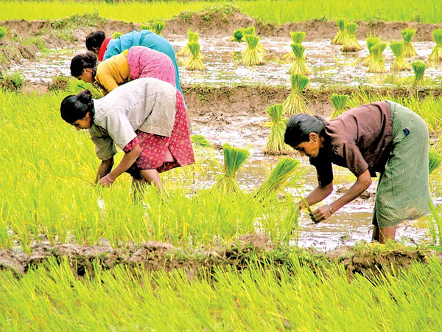
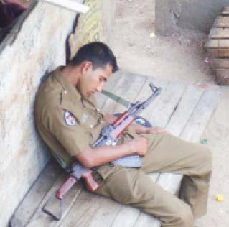
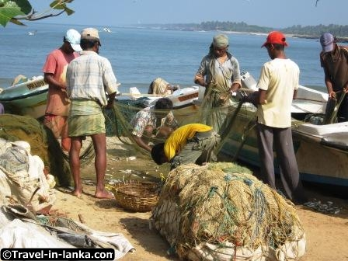
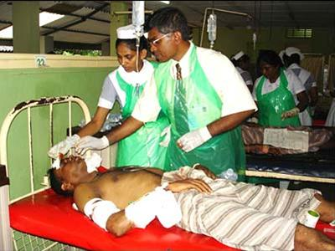

Slide 19
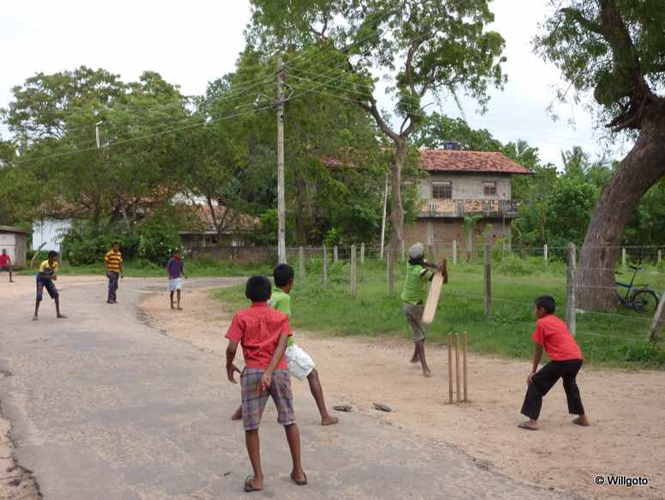
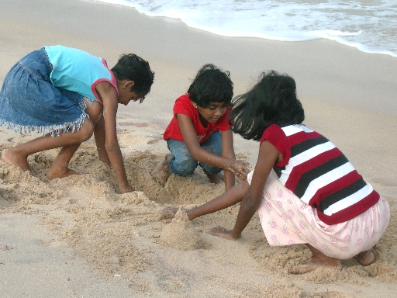
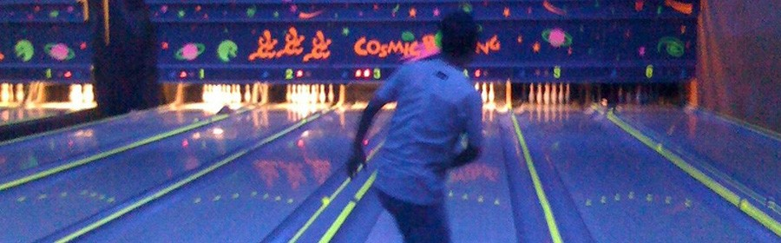

Slide 20
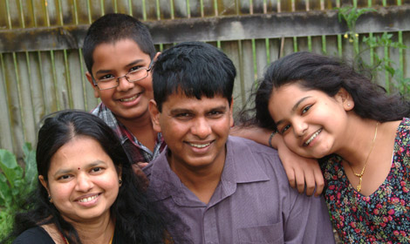
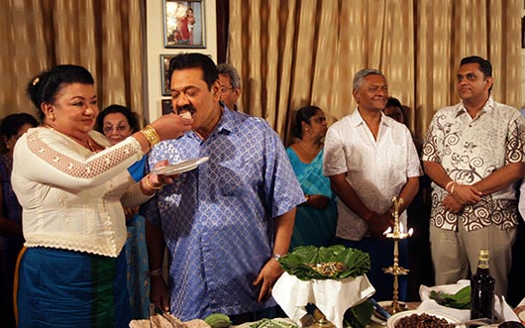

Slide 21
Health is created by;
Caring for oneself and others
Being able to take decisions and have control over life circumstances
Ensuring that the society creates conditions that allow the attainment of health by all its members
Ottawa Charter for Health Promotion, WHO, 1986

Slide 22
Health Promotion Approach
Focuses on populations in the context of everyday life rather than on at risk individuals for diseases
Is directed towards acting on determinants of health
Combines diverse but complementary methods and strategies against health hazards
Aims at community participation and is not a medical service but a health and social activity
Improves health by integrated actions at different levels on economic, environmental, social and personal factors influencing health

Slide 23
Focus = everyday life of populations Address = determinants of health Responsibility = shared Actions = multiple, continuous, complementary at different levels

Slide 24
Determinants of Health
“The range of personal, social, economic and environmental factors which determine the health status of individuals or populations”
(Nutbeam, 1998)

Slide 25
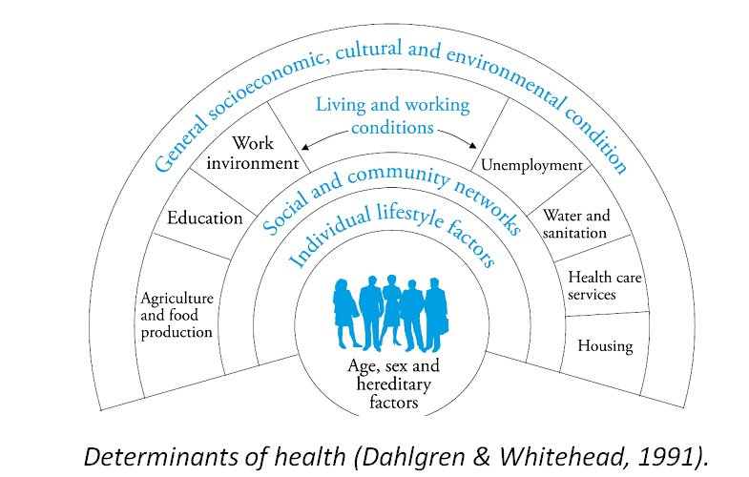

Slide 26
Reflection
Determinants of health of a 15 year old school boy/girl

Slide 27
The basis of health promotion approach is to address and modify determinants of health
Because they are multiple
Multiple actions are needed
Because they interact at various levels
Integrated actions are needed at different levels

Slide 28
How to achieve???
Advocate
Mediate
Enable

Slide 29
1. Advocate
Advocacy = The act of pleading or arguing in favor of something
Advocate to make conditions
(political, economic, social, cultural, environmental, behavioural and biological)
that affect health favourable

Slide 30
2. Mediate
Mediate = Intervene to bring about an agreement
Mediate between different sectors and interests to fulfill pre-requisites for health

Slide 31
3. Enable
Enable = acting in partnership with individuals or communities to empower them by mobilizing human and material resources necessary to improve and maintain their health
Enable people to control the determinants to achieve their fullest health potential

Slide 32
Empowerment
“Is a process through which people get greater control over decisions and actions affecting their health”
Don Nutbeam in 1998

Slide 33
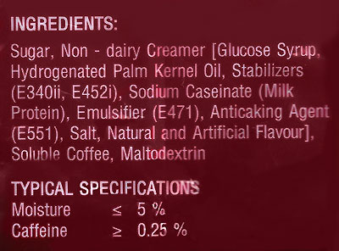

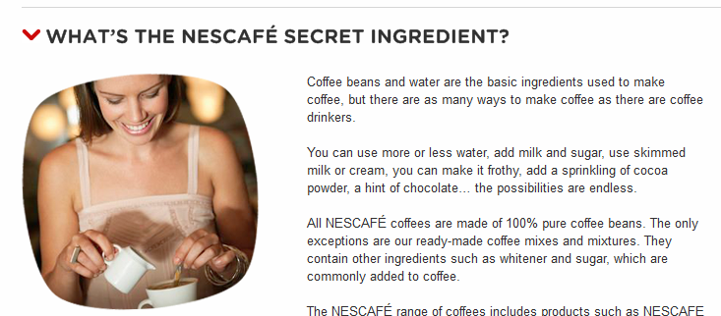
Addi. | Name | Side Effects | Remarks
E 340ii | Dipotassium hydrogenophosphate | Digestive disorders Hyperactivity | Also found in agro-chemicals
E 452i | Sodium hexametaphosphate | Kidney disease Bone disease | Confirmed effects in animal studies
E 471 | Mono- & diglycerides of fatty acids |  | Can be of animal origin (pig)
E 551 | Silicon dioxide, Amorphous | No known SE

Slide 34
Health Promotion Actions
Build healthy public policy
Create supportive environments
Strengthen community actions
Develop personal skills
Reorient health services

Slide 35
1. Build healthy public policy
Health promotion goes beyond health care
Puts health on the agenda of policy makers in all sectors and at all levels
Direct them to be aware of the health consequences of their decisions and to accept their responsibilities
Aim is to make the healthier choice the easier choice for communities as well as policy makers

Slide 36
2. Create supportive environments
Our societies are complex and interrelated
Health cannot be separated from other goals
Health promotion generates living and working conditions that are safe, stimulating, satisfying and enjoyable.

Slide 38
3. Strengthen community actions
Health promotion work through community actions in
Setting priorities
Making decisions
Planning strategies
Implementing them to achieve better health
Monitoring and evaluation

Slide 39
4. Develop personal skills
Provide information on health and opportunities for personal development
Increases the options available to the people to decide upon
Increases the control of people over their environments and living conditions

Slide 40
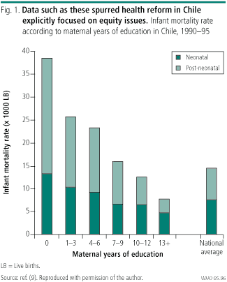
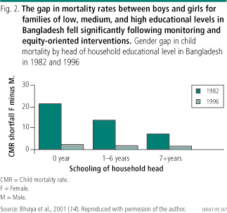
Inequities in health

Slide 42
5. Reorient Health Services
Working with people rather than for them
Responsibility for health shared among individuals, communities, governments and other agencies
Actions go beyond diagnosing and treating diseases - address social, economic and political determinants of health

Slide 43
What is the ‘role’ of a health promoter?
To be a ‘catalyst’ of initiating a process of change
Develop knowledge and skills (by building on the existing level) of the communities
Providing technical guidance to the process of evaluating and modifying the actions

Slide 44
What characteristics do you need to become a health promoter?
Ability to see a bigger picture of actions needed to create healthy communities
Ability to give up personal and professional power to negotiate, mediate and advocate
Ability to work effectively in teams
Knowledge of the broad social, economic and political determinants of health
Respect for communities

Slide 45
Group Exercise
You are interested in promoting health of the students of our Faculty – what will you do?

Slide 46
Thank you!

Slide 47
Recommended reading
Ottawa Charter for Health promotion
Available: www.who.int/healthpromotion/conferences/previous/ottawa/
Saukhya Pravardana Kriayavaliya – Prof. Diyanath Samrasinghe

